Slide 1
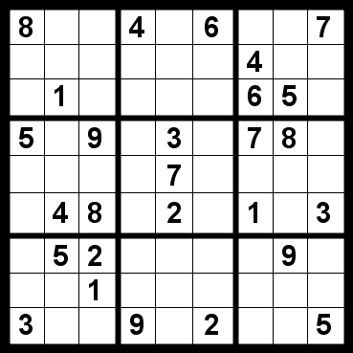
Constraint Satisfaction Problems (Ch 6)
Slides modified from Svetlana Lazebnik and Mark Hasegawa-Johnson, UIUC
8
 | 1
8
5 | 1
8
4 | 1
8
3 | 1
8 | 5
 | 1
8 | 4
 | 1
8 | 3
 | 1
8
2
5 | 1
8
5 | 1 | 9

Slide 2
Content
What is a CSP? Why is it search? Why is it special?
Examples: Map Task, N-Queens, Cryptarithmetic, Classroom Assignment
Formulation as a standard search
Backtracking Search
Heuristics to improve backtracking search
Tree-structured CSPs
NP-completeness of CSP in general; the SAT problem
Local search, e.g., hill-climbing

Slide 3

What is search for?
Assumptions: single agent, deterministic, fully observable, discrete environment
Search for planning
The path to the goal is the important thing
Paths have various costs, depths
Search for assignment
Assign values to variables while respecting certain constraints
The goal (complete, consistent assignment) is the important thing

Slide 4
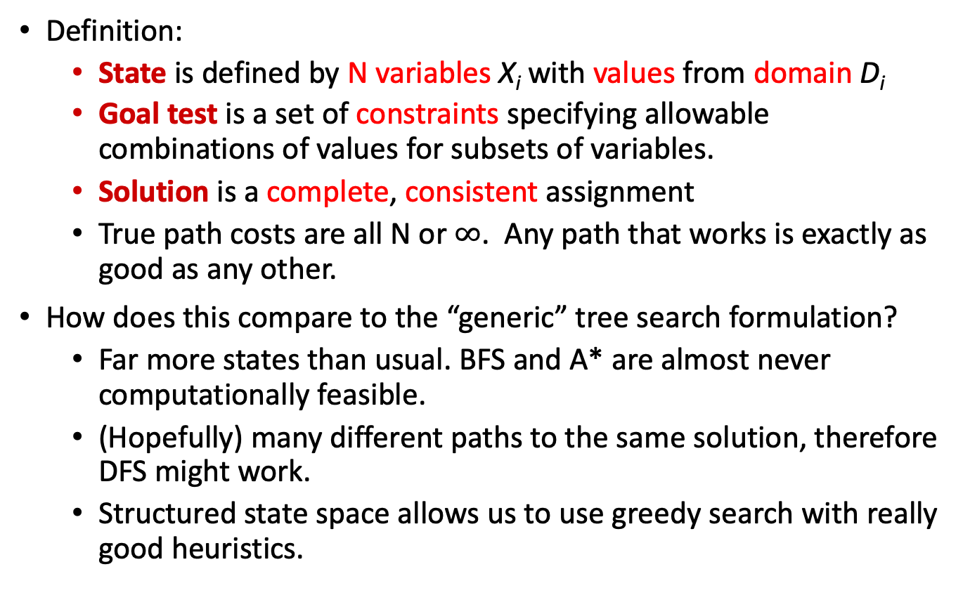
Constraint satisfaction problems (CSPs)
Definition:
State is defined by N variables X_{i} with values from domain D_{i}
Goal test is a set of constraints specifying allowable combinations of values for subsets of variables.
Solution is a complete, consistent assignment
True path costs are all N or $∞$. Any path that works is exactly as good as any other.
How does this compare to the “generic” tree search formulation?
Far more states than usual. BFS and A* are almost never computationally feasible.
(Hopefully) many different paths to the same solution, therefore DFS might work.
Structured state space allows us to use greedy search with really good heuristics.

Slide 5
Examples

Slide 6
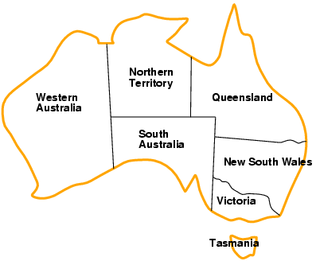
Example: Map Coloring
Variables: WA, NT, Q, NSW, V, SA, T
Domains: {red, green, blue}
Constraints: adjacent regions must have different colors
Logical representation: WA ≠ NT
Set representation: (WA, NT) in {(red, green), (red, blue), (green, red), (green, blue), (blue, red), (blue, green)}

Slide 7
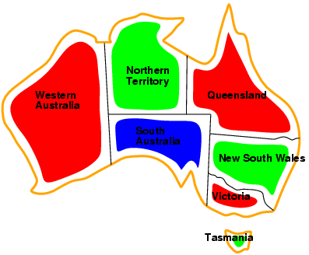
Example: Map Coloring
Solutions are complete and consistent assignments, e.g., WA = red, NT = green, Q = red, NSW = green, V = red, SA = blue, T = green

Slide 8


Example: n-queens problem
Put n queens on an n × n board with no two queens on the same row, column, or diagonal

Slide 9

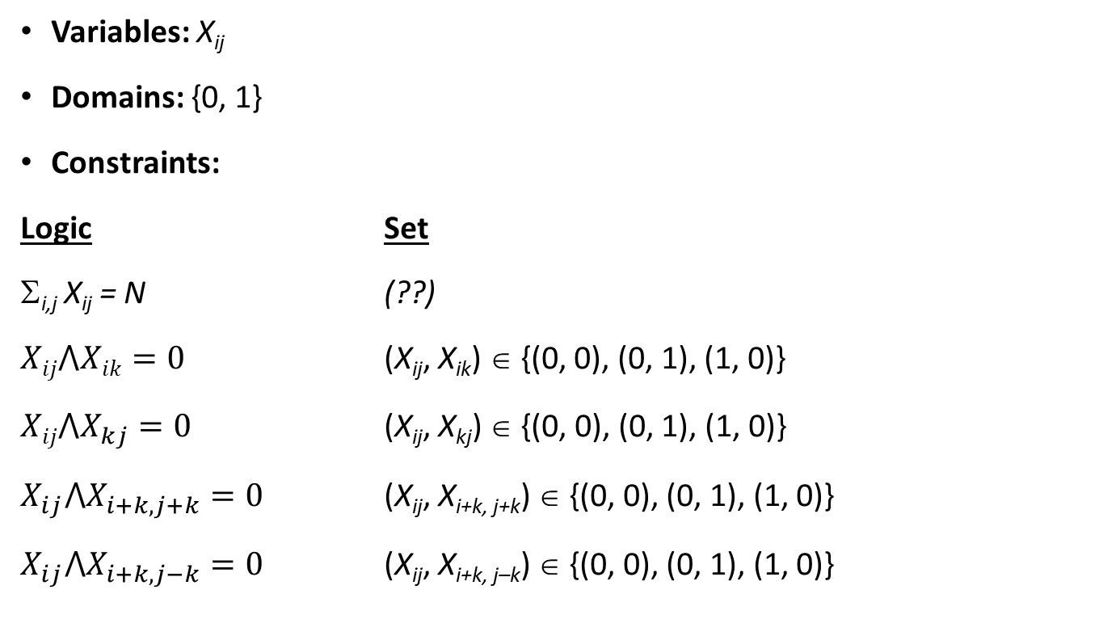
Example: N-Queens
Variables: X_{ij}
Domains: {0, 1}
Constraints:
Logic Set
Σ_{i,j} X_{ij} = N (??)
$Xij⋀Xik=0$ (X_{ij}, X_{ik}) ∈ {(0, 0), (0, 1), (1, 0)}
$Xij⋀X_{kj}=0$ (X_{ij}, X_{kj}) ∈ {(0, 0), (0, 1), (1, 0)}
$X_{ij}⋀X_{i+k,j+k}=0$ (X_{ij}, X_{i+k, j+k}) ∈ {(0, 0), (0, 1), (1, 0)}
$X_{ij}⋀X_{i+k,j−k}=0$ (X_{ij}, X_{i+k, j–k}) ∈ {(0, 0), (0, 1), (1, 0)}
X_{ij}

Slide 10
N-Queens: Alternative formulation
Variables: Q_{i}
Domains: {1, … , N}
Constraints:
∀ i, j non-threatening (Q_{i} , Q_{j})
Q₁
Q₂
Q₃
Q₄

Slide 11
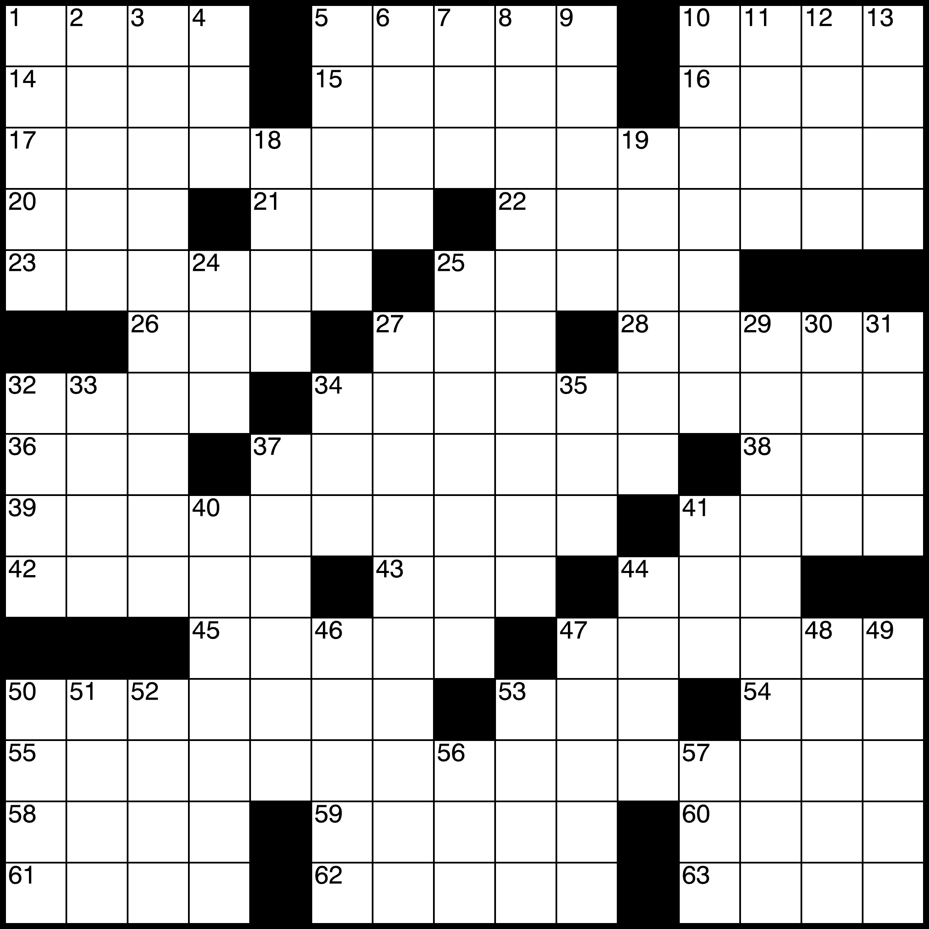
Example: Crossword Puzzle
Variables: 193 squares
Domains: {a,b,…,z}
Constraints:
Each row-segment is a word from the dictionary.
Each column-segment is a word from the dictionary.

Slide 12
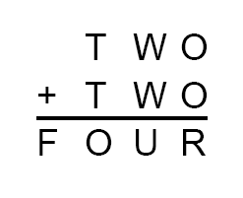
Example: Cryptarithmetic
Variables: T, W, O, F, U, R, X, Y
Domains: {0, 1, 2, …, 9}
Constraints:
O + O = R + 10 * Y
W + W + Y = U + 10 * X
T + T + X = 10 * F
Alldiff(T, W, O, F, U, R, X, Y)
T ≠ 0, F ≠ 0, X ≠ 0
X Y

Slide 13
Real-world CSPs
Assignment problems
e.g., who teaches what class
Timetable problems
e.g., which class is offered when and where?
Transportation scheduling
Factory scheduling
More examples of CSPs: http://www.csplib.org/

Slide 14
Formulation as a standard search

Slide 15
Standard search formulation (incremental)
States:
Variables and values assigned so far
Initial state:
The empty assignment
Action:
Choose any unassigned variable and assign to it a value that does not violate any constraints
Fail if no legal assignments
Goal test:
The current assignment is complete and satisfies all constraints

Slide 16
Standard search formulation (incremental)
What is the depth of any solution (assuming N variables)?
Answer: N (this is good)
Given that there are D possible values for any variable, how many paths are there in the search tree?
Answer: N! D^{N} (this is bad)
All paths have the same depth, so complexity of DFS and BFS are the same (both O(N! D^{N})
Other reasons to use DFS:
There are usually many paths to the solution (at least N!)
Often, if a path fails, we can detect this early
Today’s goal: develop heuristics to reduce the branching factor

Slide 17

Video of Demo Coloring -- DFS
From http://ai.berkeley.edu/lecture_slides.html

Slide 18
Backtracking search

Slide 19
Backtracking search
In CSP’s, variable assignments are commutative
For example, [WA = red then NT = green] is the same as [NT = green then WA = red]
We only need to consider assignments to a single variable at each level (i.e., we fix the order of assignments)
Then there are only D^{N} paths. We have eliminated the N! redundancy by arbitrarily choosing an order in which to assign variables.
Depth-first search for CSPs with single-variable assignments is called backtracking search

Slide 20

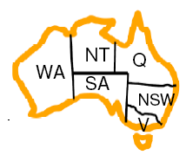
Example

Slide 21
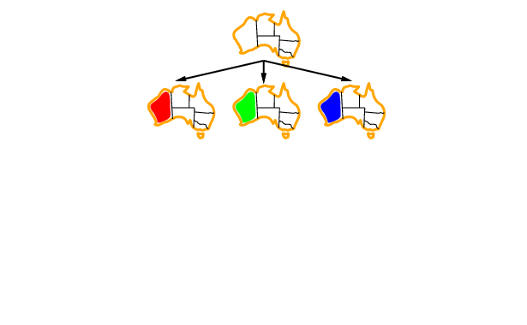
Example

Slide 22
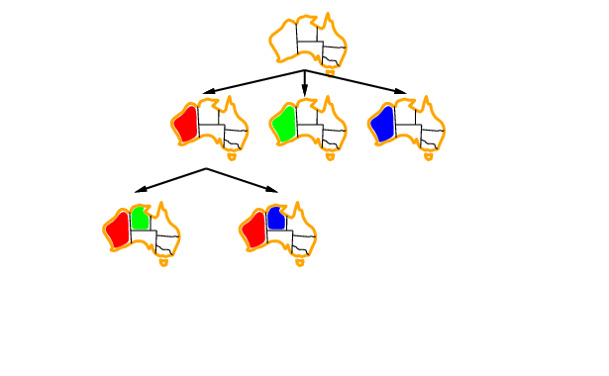
Example

Slide 23
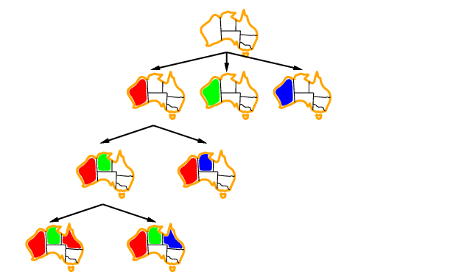
Example

Slide 24
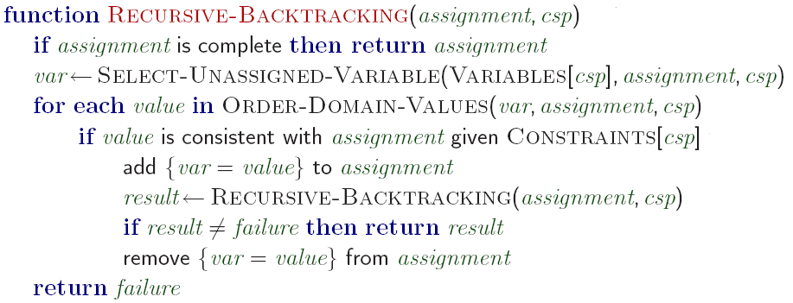
Backtracking search algorithm
Making backtracking search efficient:
Which variable should be assigned next?
In what order should its values be tried?
Can we detect inevitable failure early?

Slide 25
Video of Demo Coloring – Backtracking
From http://ai.berkeley.edu/lecture_slides.html

Slide 26
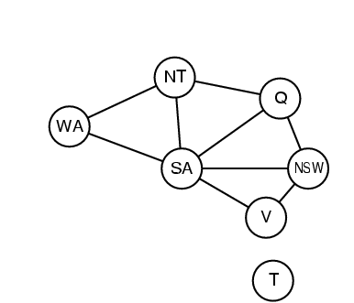
Constraint graph
Binary CSP: each constraint relates two variables Constraint graph: nodes are variables, arcs are constraints

Slide 27
Varieties of constraints
Unary constraints involve a single variable,
e.g., SA ≠ green
Binary constraints involve pairs of variables,
e.g., SA ≠ WA
Higher-order constraints involve 3 or more variables,
e.g., cryptarithmetic column constraints

Slide 28
Heuristics for making backtracking search more efficient

Slide 29
Heuristics for making backtracking search more efficient
Still DFS, but we use heuristics to decide which child to expand first.
Heuristics that choose the next variable to assign:
Minimum Remaining Values (MRV)
Degree Heuristic
Heuristic that chooses a value for that variable:
Least Constraining Assignment (LCA)
Early detection of failure:
Forward Checking
Arc Consistency

Slide 30

Minimum Remaining Values(MRV)
Most constrained variable:
choose the variable with the fewest legal values

Slide 31

Degree Heuristic
Tie-breaker among most constrained variables
Most constraining variable:
choose the variable with the most constraints on remaining variables

Slide 32
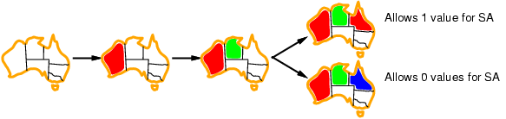
Least constraining value
Given a variable, choose the least constraining value:
the one that rules out the fewest values in the remaining variables
Combining these heuristics makes 1000 queens feasible

Slide 33
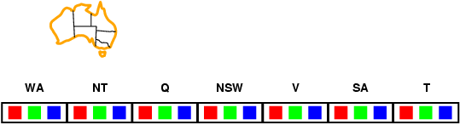
Forward checking
Idea:
Keep track of remaining legal values for unassigned variables
Terminate search when any variable has no legal values

Slide 34
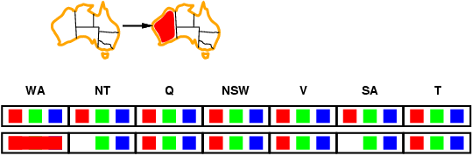
Forward checking
Idea:
Keep track of remaining legal values for unassigned variables
Terminate search when any variable has no legal values

Slide 35
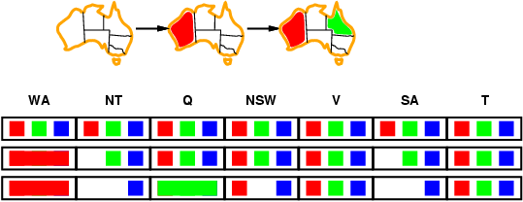
Forward checking
Idea:
Keep track of remaining legal values for unassigned variables
Terminate search when any variable has no legal values

Slide 36
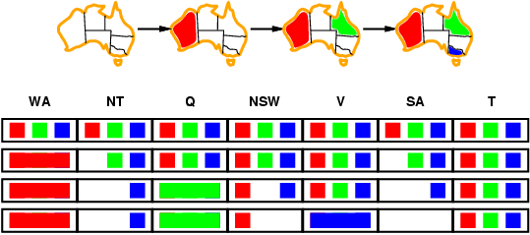
Forward checking
Idea:
Keep track of remaining legal values for unassigned variables
Terminate search when any variable has no legal values

Slide 37
Video of Demo Coloring – Backtracking with Forward Checking
From http://ai.berkeley.edu/lecture_slides.html

Slide 38
Video of Demo Coloring – Backtracking with Forward Checking – Complex Graph

Slide 39
Constraint propagation
Forward checking propagates information from assigned to unassigned variables, but doesn't provide early detection for all failures:
NT and SA cannot both be blue! Constraint propagation repeatedly enforces constraints locally

Slide 40
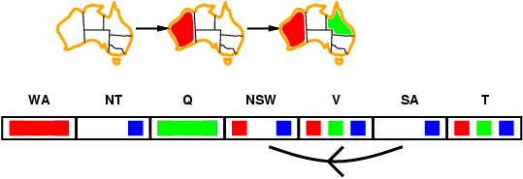
Arc consistency
Simplest form of propagation makes each arc consistent
X →Y is consistent iff
for every value x of X there is some allowed y

Slide 41
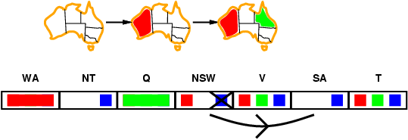
Arc consistency
Simplest form of propagation makes each arc consistent
X →Y is consistent iff
for every value x of X there is some allowed y

Slide 42
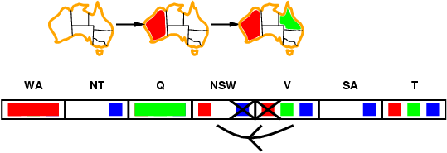
Arc consistency
Simplest form of propagation makes each arc consistent
X →Y is consistent iff
for every value x of X there is some allowed y
If X loses a value, neighbors of X need to be rechecked

Slide 43
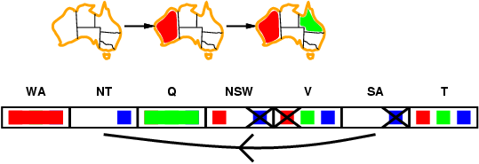
Arc consistency
Simplest form of propagation makes each arc consistent
X →Y is consistent iff
for every value x of X there is some allowed y
If X loses a value, neighbors of X need to be rechecked
Arc consistency detects failure earlier than forward checking
Can be run as a preprocessor or after each assignment

Slide 44
NP-Completeness and the SAT Problem

Slide 45
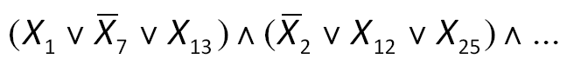
Computational complexity of CSPs
The satisfiability (SAT) problem:
Given a Boolean formula, is there an assignment of the variables that makes it evaluate to true?
SAT is NP-complete
NP: a class of decision problems for which
the “yes” answer can be verified in polynomial time
no known algorithm can find a “yes” answer, from scratch, in polynomial time
An NP-complete problem is in NP and every other problem in NP can be efficiently reduced to it (Cook, 1971)
Other NP-complete problems: graph coloring, n-puzzle, generalized sudoku
It is not known whether P = NP, i.e., no efficient algorithms for solving SAT in general are known

Slide 46
Local search, e.g., hill climbing

Slide 47
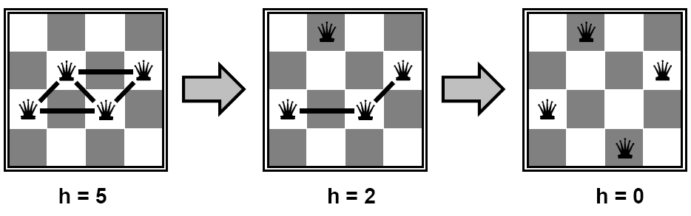
Local search for CSPs
Start with “complete” states, i.e., all variables assigned
Allow states with unsatisfied constraints
Attempt to improve states by reassigning variable values
Hill-climbing search:
In each iteration, randomly select any conflicted variable and choose value that violates the fewest constraints
I.e., attempt to greedily minimize total number of violated constraints
h = number of conflicts

Slide 48
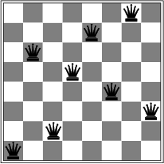
Local search for CSPs
Start with “complete” states, i.e., all variables assigned
Allow states with unsatisfied constraints
Attempt to improve states by reassigning variable values
Hill-climbing search:
In each iteration, randomly select any conflicted variable and choose value that violates the fewest constraints
I.e., attempt to greedily minimize total number of violated constraints
Problem: local minima
h = 1

Slide 49
Applications that look a lot like intelligence…

Slide 50
Summary
CSPs are a special kind of search problem:
States defined by values of a fixed set of variables
Goal test defined by constraints on variable values
Backtracking = depth-first search where successor states are generated by considering assignments to a single variable
Variable ordering and value selection heuristics can help significantly
Forward checking prevents assignments that guarantee later failure
Constraint propagation (e.g., arc consistency) does additional work to constrain values and detect inconsistencies
Complexity of CSPs
NP-complete in general (exponential worst-case running time)
Alternatives to backtracking search: local search

Slide 51
Acknowledgements
Slides based on:
Pieter Abbeel and Dan Klein (UC Berkeley)
Mark Hasegawa-Johnson and Julia Hockenmaier (UIUC)
Tauhidul Alam (LSUS)
http://aima.eecs.berkeley.edu/slides-ppt/

